Slide 1



Slide 2
CONTENTS
OBJECTIVE
LITERATURE SURVEY
EXISTING SYSTEM
PROPOSED SYSTEM
NODEMCU
DATASHEET-NODEMCU
NODEMCU-POWER MANAGEMENT
000WEBHOST
SCHEMATIC DIAGRAM
BREADBOARD DESIGN
PCB REFERENCE
TOOLS
CONCLUSION
REFERENCE
SCHEDULED COURSE PLAN
NANO-TECHNOLOGY

Slide 3
OBJECTIVE
To monitor the increasing level of toxic gases in the atmosphere continuously.
To give an update of the quality of air in a particular region in particular interval of time and update it continuously to the end user.
To generate a detailed analysis of the quality of air in a particular region automatically without any need for manual intervention.
To identify the gas which is creating an insidious situation in the particular area through these results and eradicating or controlling its root cause.
To improvise the networking For Longer Area Coverage i.e, up to 50km for one admin.

Slide 4
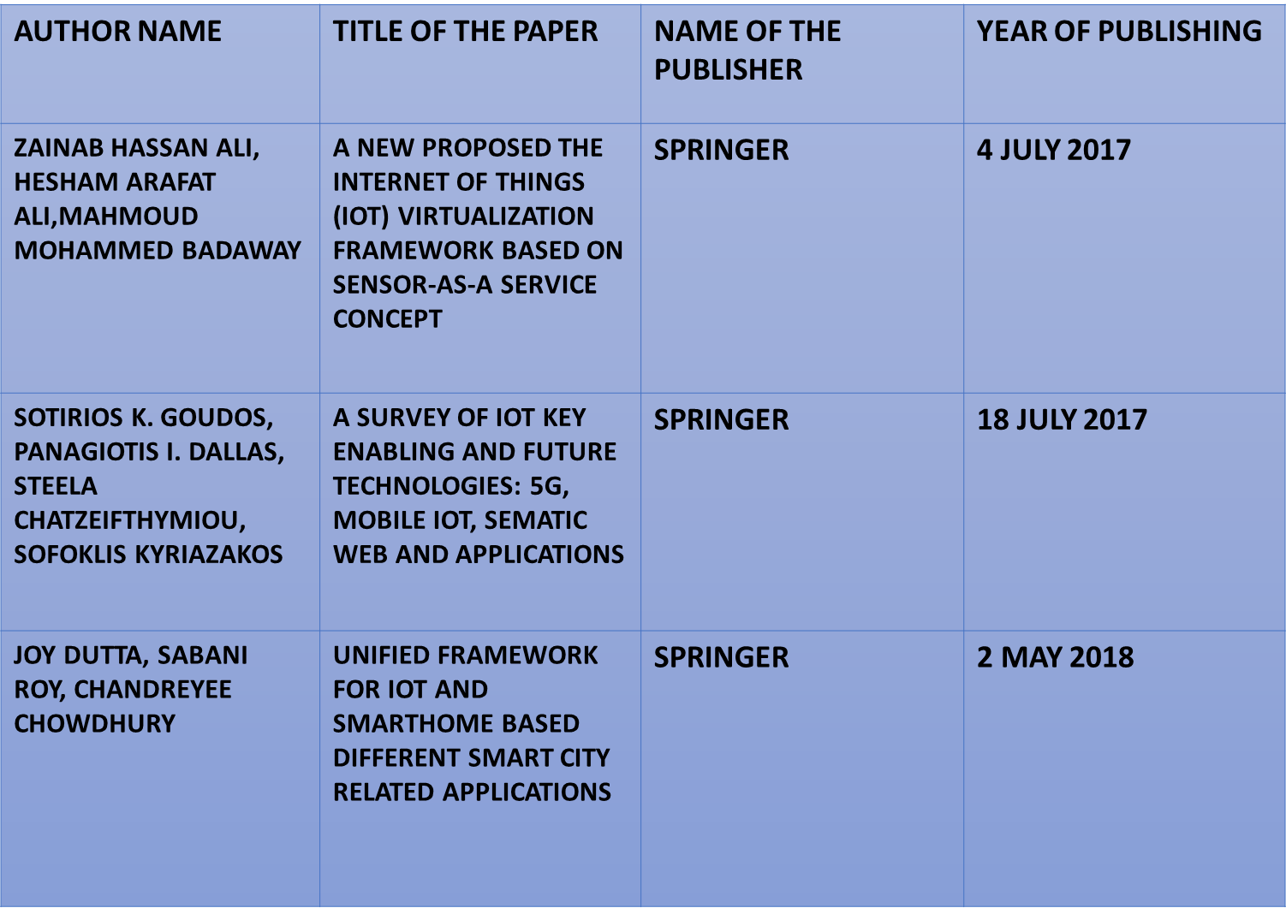
LITERATURE SURVEY

Slide 5
EXISTING SYSTEM
In our project, we have collected the quality of air in the rate of ppm via the gas sensor.
The collected data is then send to a MCU (Ardiuno) where the analog data is converted into digital data.
The digital data obtained from the MCU is then send to ESP-01 belonging to 802.11/n/g for transmission of data to the local server.
The data is initially viewed in LCD connected to the MCU for checking purpose.
The WIFI is configured with the server and the data is transmitted via the WIFI.
The data is then accessed via the Localhost and had been viewed in the web browser.

Slide 6
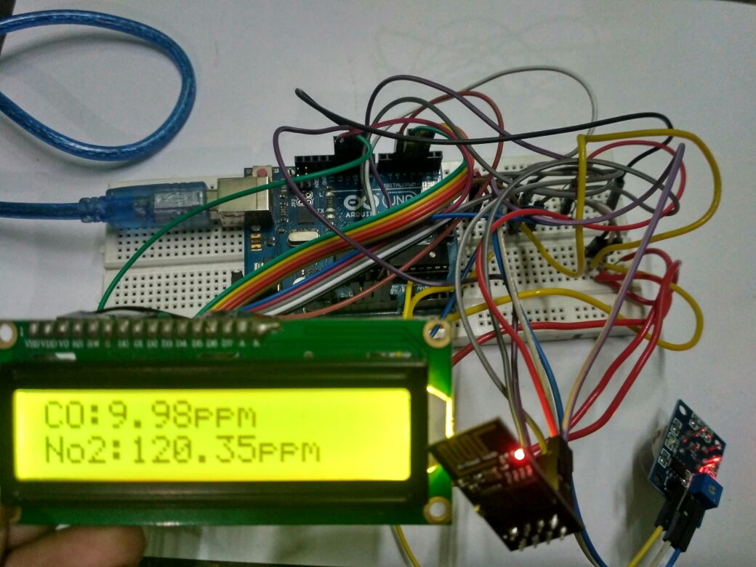
QADSM (EXISTING CONT.,)
FIG.1 EXISTING SYSTEM

Slide 7
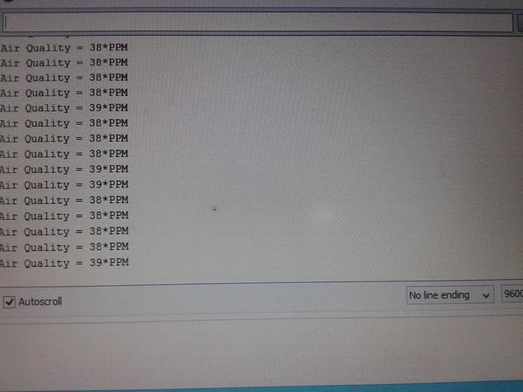
(EXISTING CONT.,)
FIG.2 SERIAL MONITOR

Slide 8
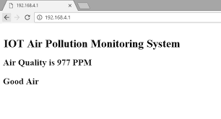
WEB HOSTING (EXISTING CONT.,)
FIG.3 WEB HOSTING

Slide 9
PROPOSED SYSTEM
In order to overcome the power consumption issue using Arduino Microcontroller, we are using NODEMCU as a replacement, whose power consumption is only 3.4-3.6v. It doesn’t need an extra WIFI attachment to the circuit as it has WIFI embedded in it. It has on board antenna and RF balun which is helpful in long distance data transmission.
The data from each node is accessed via the gateway concept where in the sensor from a particular region are connected to a single module and with the help of that module the data from the corresponding modules could be easily accessed.

Slide 10
(PROPOSED CONT.,)
DATA HOSTING METHOD:
In this system we are using the Google firebase console and also 000webhost.com for website creation which enables the end user to view the data. This reduces the dependency of online platforms for data viewing.
This method helps in easy access of data from any module at any time without disturbing other module data output.
In earlier version of air quality monitoring, the HTTP protocol has been used which lead to insecurity of the data.

Slide 11
(PROPOSED CONT.,)
This process eliminates the need for configuring each and every module to the website. It only needs in configuring only the gateway module to the website which reduces the coding complexity.
In a single router 16 modules could be connected, so an area of 6.5km could be covered in a single router. This technique would be effectively used to cover an entire district with a minimum number of routers.

Slide 12
(PROPOSED CONT.,)
In order to secure the data MQTT protocol has been used in the proposed system.
This protocol so far has been explained theoretical only.
This protocol is an ISO standard publish subscribe based messaging protocol.
It is designed for connections with remote locations, which would be useful to collect data in any region.

Slide 13
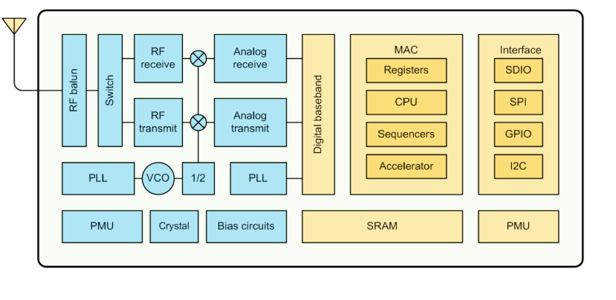
FIG.4 DATASHEET-NODEMCU
NODE MCU ARCHITECTURE (PROPOSED CONT..,)

Slide 14
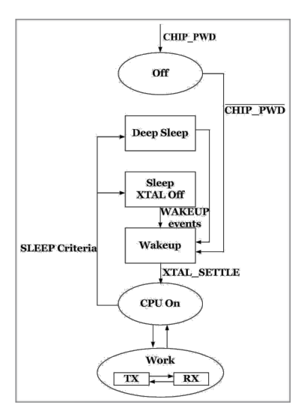
FIG.5 POWER MANAGEMENT
(PROPOSED CONT..,)

Slide 15
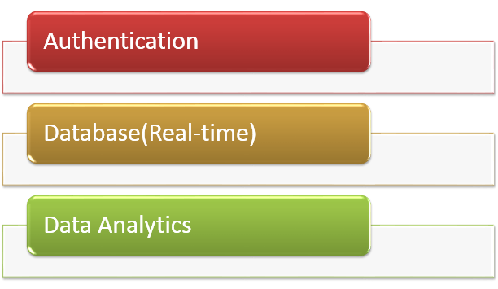
( PROPOSED CONT..,)
FIG.6 000WEBHOST

Slide 16
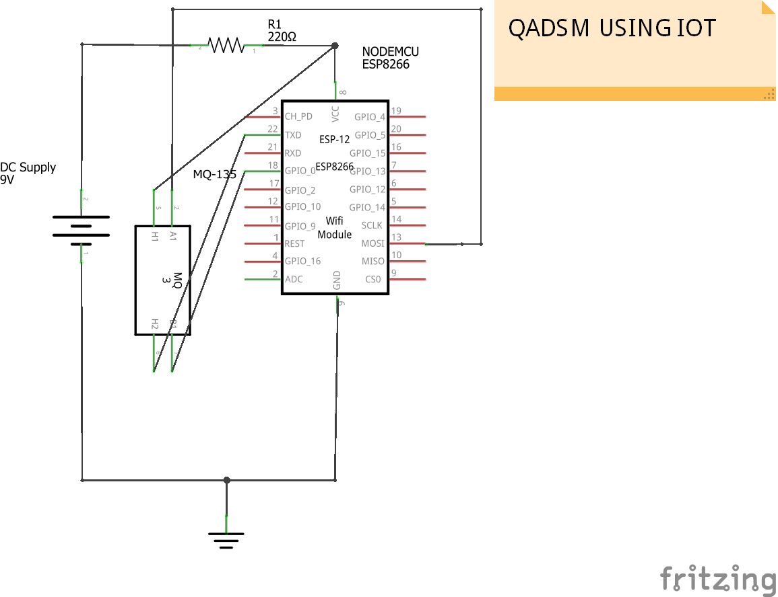
(PROPOSED CONT..,)
FIG.7 SCHEMATIC DIAGRAM

Slide 17
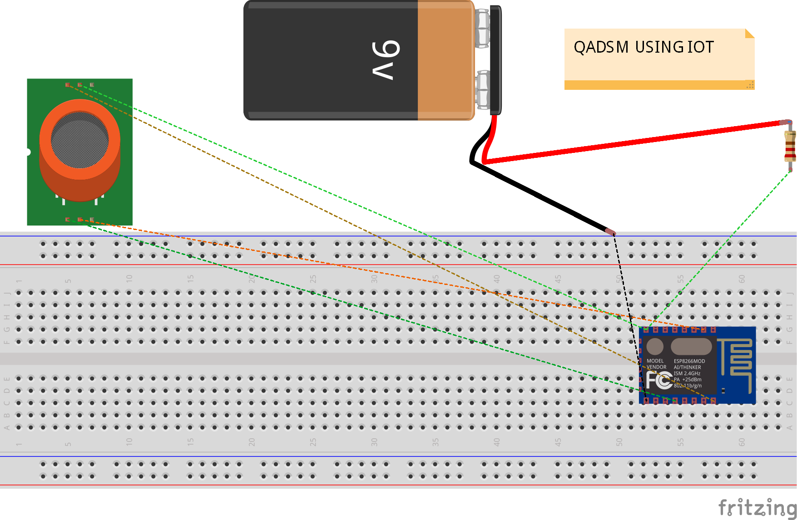
(PROPOSED CONT..,)
FIG.8 ON BREADBOARD

Slide 18
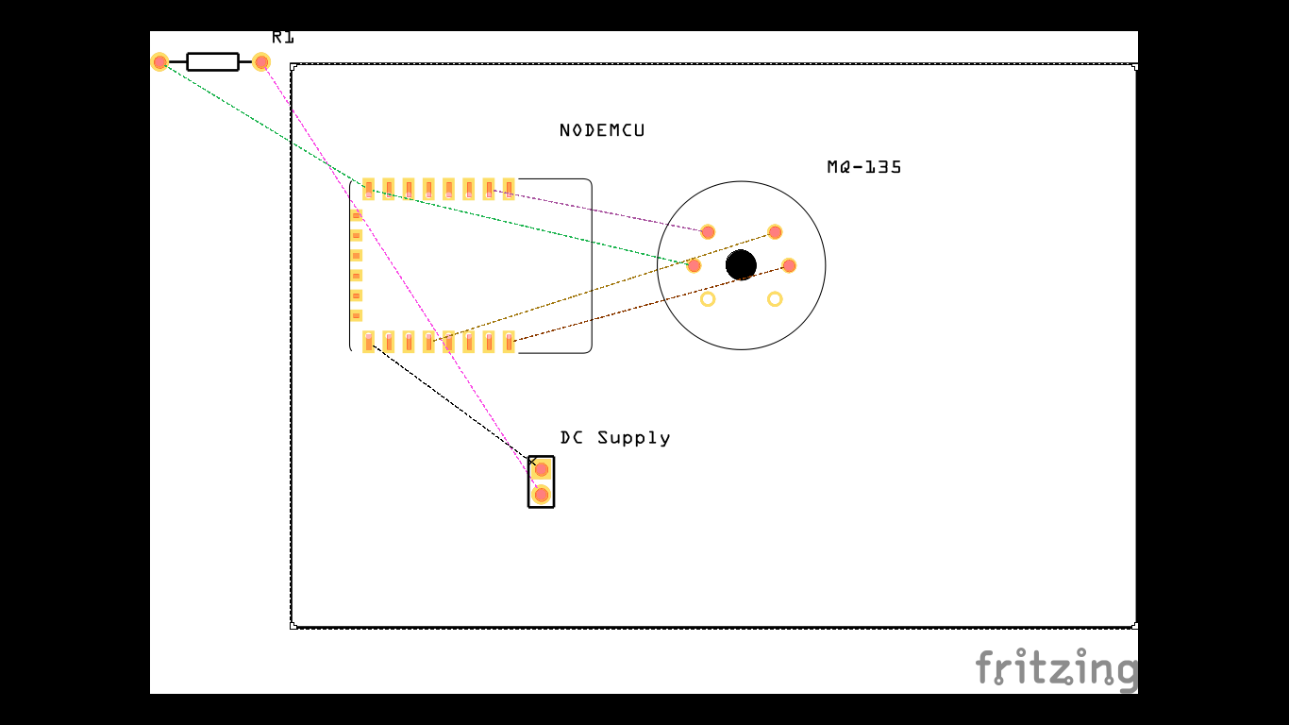
(PROPOSED CONT..,)
FIG.9 PCB REFERENCE

Slide 19
TOOLS
SOFTWARE TOOLS
Embedded code - Arduino IDE
Circuit Simulation - Fritzing
Data Analytics – 000Webhost
WebHosting – LocalServer XAMPP
OS – Linux & Windows 7

Slide 20
CONCLUSION
In order to monitor the quality of air we have so far improvised the previous system in various aspects and proved it theoretically.
We had made a BREADBOARD DESIGN and PCB REFERENCE DESIGN for a single node configuration as it would be helpful for us in our further proceedings in our project.

Slide 21
REFERENCE
[1] I. F. Akyildiz, W. Su, Y. Sankarasubramaniam, and E. Cayirci, “A survey on sensor networks,” IEEE Communications Magazine, vol. 40, no. 8, pp. 102–114, 2018.
[2] M. D. de Amorim, M. L. Sichitiu, F. Benbadis, Y. Viniotis, and S. Fdida, “Dissecting the routing architecture of selforganizing networks,” IEEE Wireless Communications, vol. 13, no. 6, pp. 98–104, 2017.
[3] M. D. de Amorim, F. Benbadis, M. L. Sichitiu, A. C. Viana, and Y. Viniotis, “Routing in Wireless Self-Organizing Networks,” Taylor and Francis Group, LLC, to appear, vol. 16, no. 7, pp. 56–74, 2017.
[4] M. Mauve, J. Widmer, and H. Hartenstein, “A survey on position-based routing in mobile ad hoc networks,” IEEE Network, vol. 15, no. 6, pp. 30–39, 2016.

Slide 22
SCHEDULED COURSE PLAN
The activities which has to be done in forthcoming weeks are as follows:
To learn languages like NODE.JS, PHPor PYTHON.
COMMUNICATION between MULTI NODE and CLIENT SERVER CONFIGURATION.

Slide 23

NANO-TECHNOLOGY

Slide 24
